Slide 1
Wildfire Smoke
California Area Indian Health Service

Slide 2
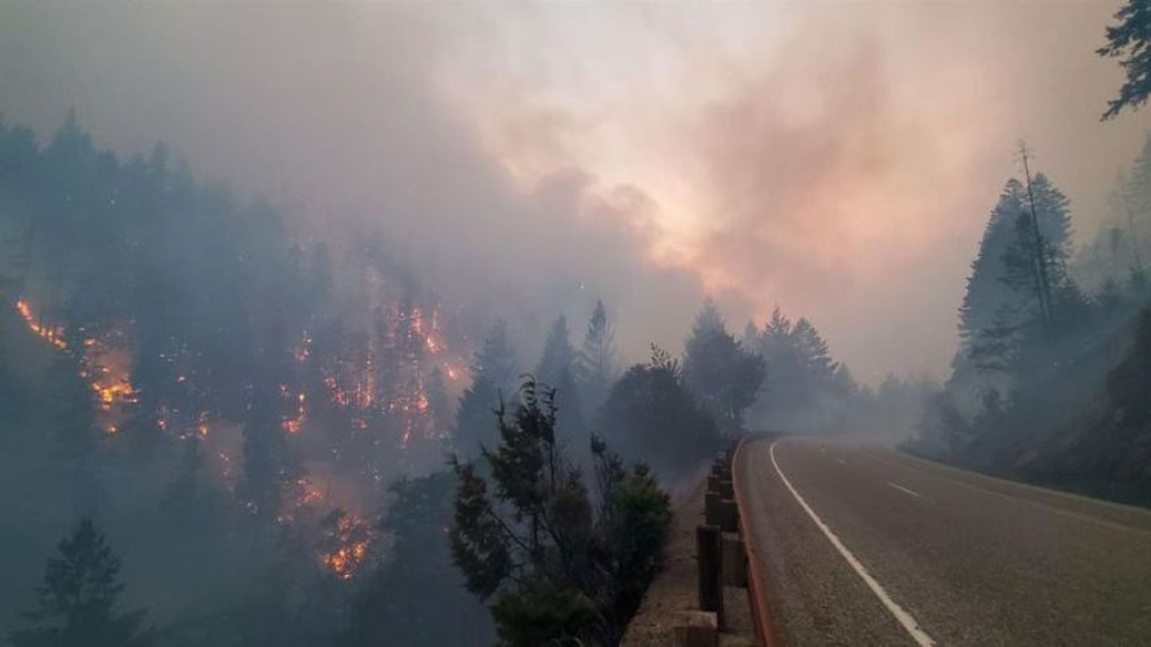
Overview
What is wildfire smoke?
Who is most at risk for negative health effects?
What are the health effects of wildfire smoke?
How does heat make the health effects worse?
What to do when wildfire smoke is in your community?
How to preparing for wildfire season.

Slide 3
What is Wildfire Smoke?
Notes:
Ask audience this question.
Follow up with “What is the component of wildfire smoke we are most concerned about?”

Slide 4
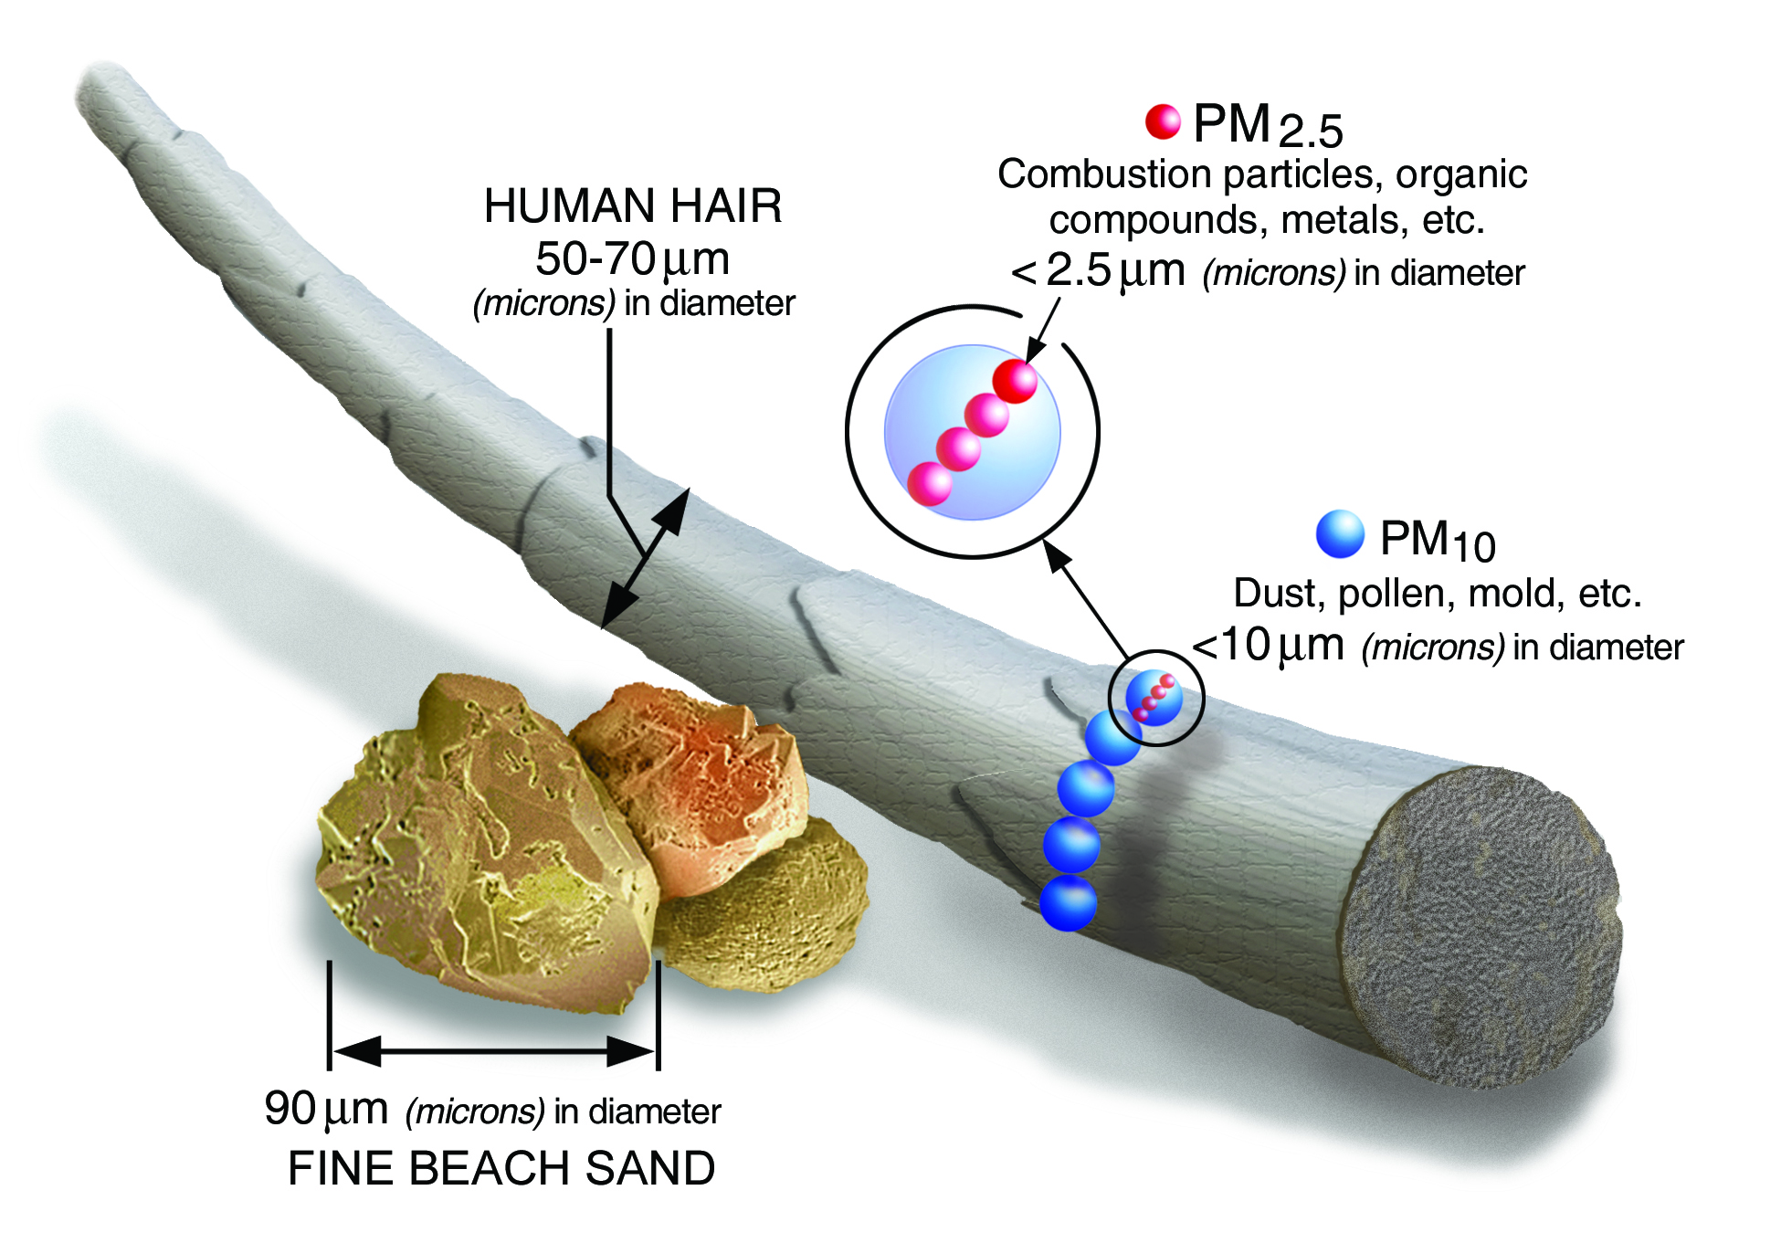
What is Wildfire Smoke?
Mix of small particles, gases, and water vapor.
Harmful components include:
  Carbon monoxide;
  Ozone;
  Volatile organic compounds;
  Particulate Matter.
    PM 2.5
      Smallest particles, biggest concern
    PM 10
Notes:
CO colorless, odorless, gas, combustion byproduct, exposure: Headache, dizziness, fatigue, shortness of breath, blurry/double vision, chest pain, nausea and vomiting
Ozone: produced in smoke plumes, exacerbate asthma, COPD, cause coughing throat irritation, congestion
VOCs: similar symptoms, except more systemic effects in liver kidneys, CNS

Slide 5
Who is most at risk?

Slide 6
Sensitive Groups
Children:
  Lungs are still growing.
  Faster breathing rate causing higher inhaled concentration relative to small body size vs. adults with the same exposure.
Older Adults:
  Have higher prevalence of lung and heart disease.
Individuals with Chronic Respiratory or Cardiovascular Disease:
  Inhaling particulate matter can aggravate these diseases and worsen symptoms.
    Asthma
    Chronic Obstructive Pulmonary Disease (COPD)
    Heart Disease
Pregnant Women:
  Have higher breathing rates and more blood volume = more particles in the body.
  Higher risk of preterm birth and lower birth weight in unborn baby.
People of lower socioeconomic status
  At an increased risk due to expense of running HVAC constantly, the high cost of portable HEPA air purifiers and less access to medical care due to cost.
Source: https://www.ncbi.nlm.nih.gov/pmc/articles/PMC9657128/

Slide 7
What are the health effects of exposure to wildfire smoke?

Slide 8
Health Impacts of Wildfire Smoke
Symptoms of wildfire smoke exposure vary based on:
  Pre-existing medical conditions;
  Age;
  Levels of PM 2.5 present in community;
  Exposure time.
Short term exposure:
  Healthy Adults & Children Health Effects: eye/nose/throat irritation, coughing, phlegm, chest tightness, difficulty breathing or shortness of breath with exertion.
  Sensitive Group Health Effects: aggravates lung disease, develop acute bronchitis and can trigger asthma attacks, heart attack, heart arrhythmias and stroke.
Long term exposure:
  Reduced lung function, chronic bronchitis and premature death.
  Air pollution shortens lifespan of 1.5 years on average throughout the USA*.
*Source: Cardiovascular Research, Vol. 116, Issue 7, June 2020 pp.1334
https://academic.oup.com/cardiovascres/article/116/11/1910/5770885
Notes:
Source: Cal EPA Air Resources Board: Fact Sheet Smoke Management and Public Health (2/2003); EPA 452/R-19-901 Wildfire Smoke a Guide for Public Health Officials Rev. 2019

Slide 9
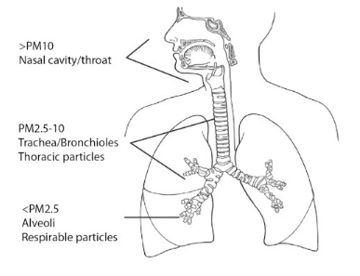
Why is PM 2.5 Harmful?
Particles 2.5 micrometers or smaller can travel deep into lungs and possibly enter bloodstream.
  This causes damage to lungs and can impair lung function.
  Damage to lungs and possible plaque formation in arteries puts more strain on your heart to maintain oxygen levels.
Image Source: Impacts of Particulate Matter | Dust Mitigation Handbook (swclimatehub.info)
Notes:
https://www.ncbi.nlm.nih.gov/pmc/articles/PMC4740125/

Slide 10
Wildfire Smoke and Excess Heat
Rahman et al. 2022
  Study from 2014 to 2019, found that excess heat and PM 2.5 exposure had synergistic effect on mortality (death) risk.
  Exposure to both heat and particulate air pollution increased mortality risk by more than the sum of the increased mortality risk associated with each exposure individually (5-6%).
    Mortality risk increased by over 21% on days with exposure to both heat and particulate air pollution versus 5% increase with heat and 6% increase with particulates.
  Effect largely seen in patients over 75 years old.
Novoselov, 2022
  42% of Californians were exposed to combo of extreme heat and PM 2.5 in 2020, with rural residents most affected.
  More research needs to be done to more accurately define the risk and mechanisms involved.
  Exposures to smoke and excess heat are expected to only get worse due to climate change.

Slide 11
What to do when there is wildfire smoke in your area?

Slide 12
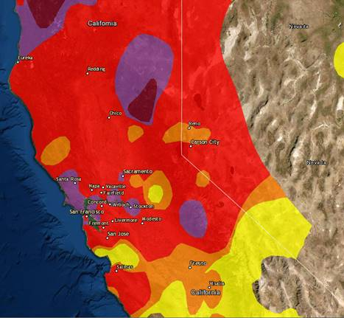
When Smoke is Present
Monitor Local Air Quality:
  PREFERRED: Local Air Quality Management District.
    Will have the most site specific information for your area
    https://ww2.arb.ca.gov/california-air-districts
  fire.airnow.gov
    Show most current PM 2.5 AQI levels.
Northern California Air Quality per AirNow.gov 9/11/2020

Slide 13
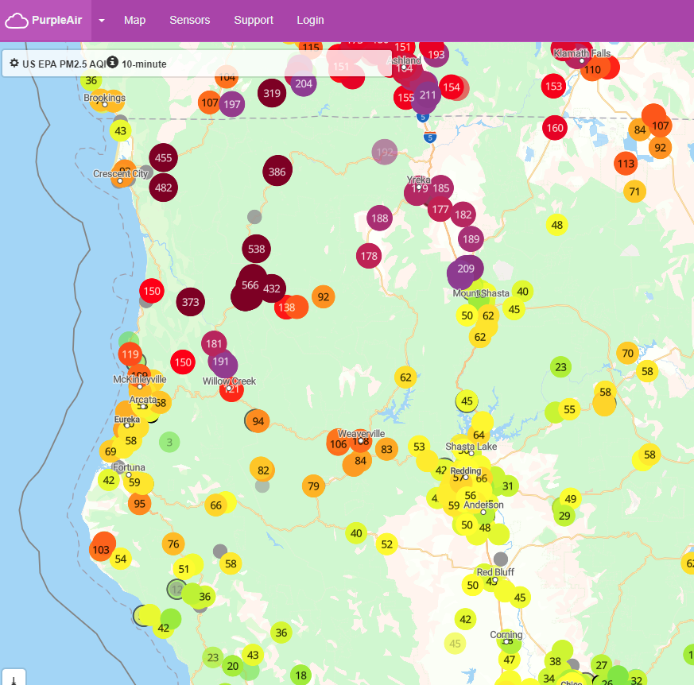
When Smoke is Present
PurpleAir Real-time Air Quality Monitoring
Purple Air is not accurate when readings are above 150 AQI.*
Recommend using fire.airnow.gov as it includes PurpleAir data, but corrected for the associated instrument error.
*Source: Barkjohn, Karoline et. Al. Correction and Accuracy of PurpleAir PM2.5 Measurements For Extreme Wildfire Smoke. Sensors 2022, 22, 9669. https://doi.org/10.3390/s22249669

Slide 14
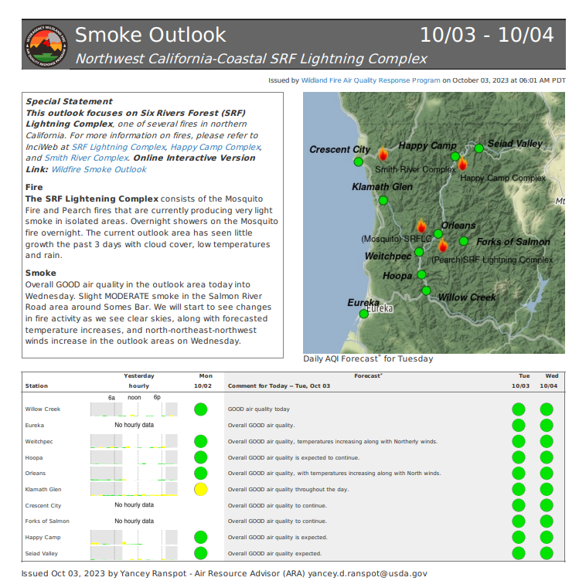
Smoke Forecasts
Interagency Wildland Fire Air Quality Response Program:
  Has more specific smoke forecast information.
  https://outlooks.airfire.org/outlook

Slide 15
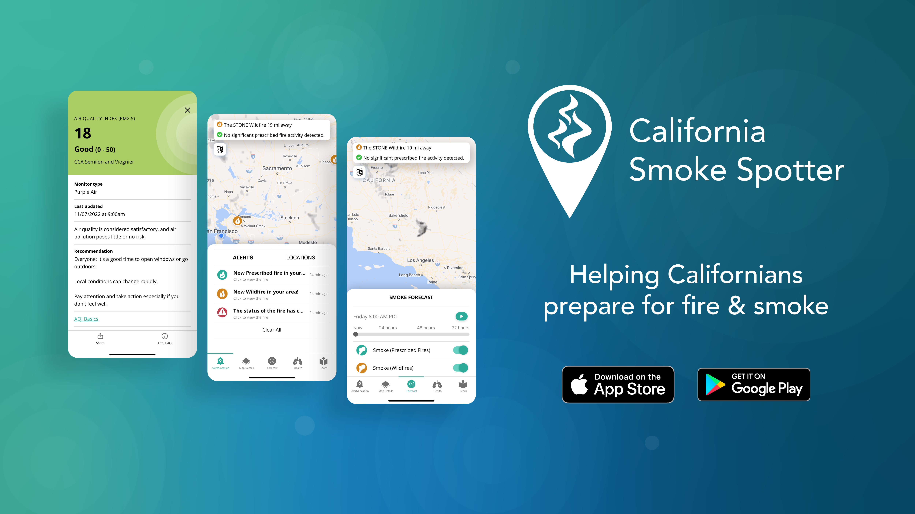
Useful App: California Smoke Spotter
This App Offers:
  72-hour smoke forecasts.
  Map of Fire Locations.
  Will send you alerts for specific locations that you tag.
  Helpful if you have family members in other locations or need to travel somewhere in CA.

Slide 16
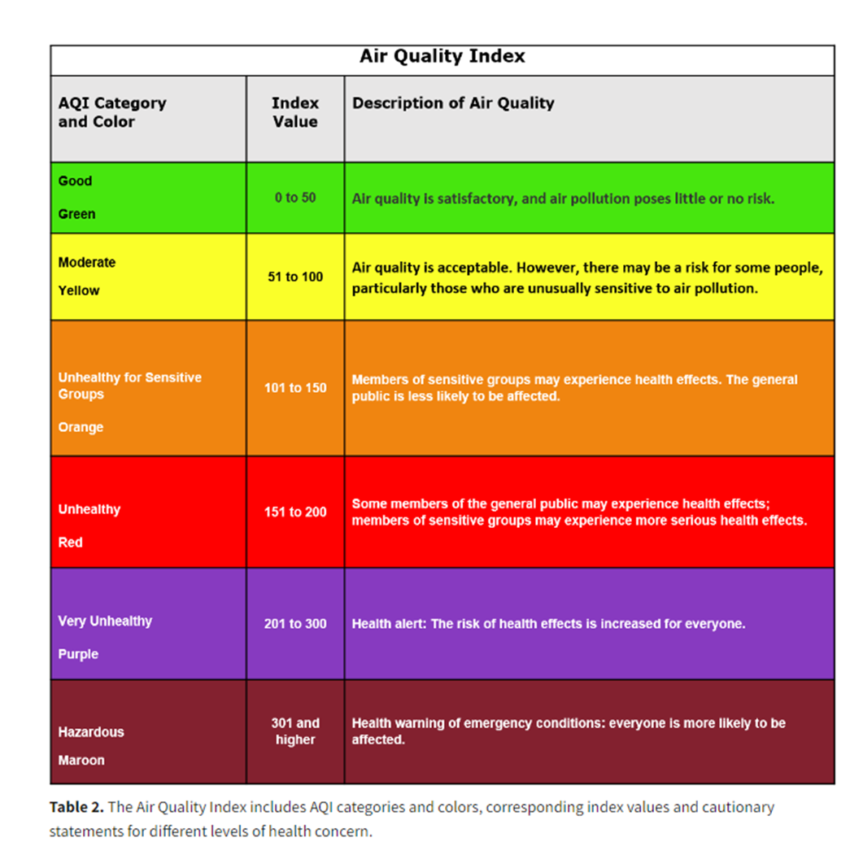
Air Quality Index
AQI is a reporting tool developed by the EPA to communicate the levels of contaminates in the air.
EPA reports AQI based on 5 major air pollutants.
  The pollutant with the highest AQI is the one reported on the website.
  For wildfire smoke we are concerned with PM 2.5.

Slide 17
When Smoke is Present
Moderate AQI (51-100) (YELLOW):
  Okay for healthy people.
  Unusually Sensitive People: Monitor symptoms, Consider taking it easy.
Unhealthy For Sensitive Groups AQI (101-150) (ORANGE):
  Sensitive Groups should reduce outdoor activity and monitor symptoms such as coughing or shortness of breath.
  People with asthma should follow action plan.
  People with Heart Disease: Watch for fatigue, palpitations, or shortness of breath. If present call healthcare provider.
Source: Air quality Guide for Particle Pollution, August 2015, EPA-456/F-15-005 (airnow.gov)

Slide 18
When Smoke is Present
Unhealthy AQI (151-200) (RED):
  Sensitive Groups should avoid heavy exertion and should spend more time indoors.
  Healthy people should reduce exertion and take more breaks when outdoors.
  Keep windows and doors closed at home.
  Use AC in recirculate mode (car and home).
  Avoid operating window fans.
  Avoid generating indoor pollutants (vacuuming, frying/broiling food indoors, spraying aerosol products, burning candles).

Slide 19
When Smoke is Present
Very Unhealthy AQI (201-300) (PURPLE):
  Sensitive Groups should avoid all physical outdoor activity.
  Healthy People should avoid heavy exertion and should spend more time indoors.
  Use a portable air cleaner (HEPA air purifier) at home.
Hazardous AQI (301-500) (MAROON):
  Everyone should avoid outdoor physical activity.
    Stay indoors; only go outside for essential activities and wear an N95 respirator.
  Sensitive Groups should remain indoors and maintain low activity levels.
    Have someone check on you or assist with essential outdoor activities.
    If you must go outside wear an N95 respirator if your doctor says it is okay for you to do so.

Slide 20
When Smoke is Present
At home:
  Close all windows and doors.
  Ensure air conditioning system is not drawing in outdoor air.
    Use recirculate mode.
  If using a window AC:
    Close the outdoor air damper.
    If you cannot, it is recommended to not use it.
If you must go outside, wear an N95 respirator.
  If you are considered sensitive to Wildfire smoke, talk to your doctor before wearing one.
Avoid adding pollutants to indoor air such as:
  Smoking.
  Using gas, propane, or wood burning stoves.
  Spraying aerosols (like Febreze).
  Frying or broiling foods.
  Dry Vacuuming (disturbs dust).
  Burning candles, incense or sage.
Source: https://www.epa.gov/indoor-air-quality-iaq/wildfires-and-indoor-air-quality-iaq

Slide 21
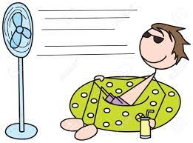
When Smoke and Excessive Heat are Present
If you do not have air conditioning in your home or it is too expensive to run it, have a plan to spend the hottest part of the day at a cooling center.
  Possible public locations with air conditioning that can offer respite from the heat and smoke include:
    Libraries,
    Community Centers,
    Public Indoor Swimming Pools,
    Senior Centers,
    Recreation Centers.

Slide 22
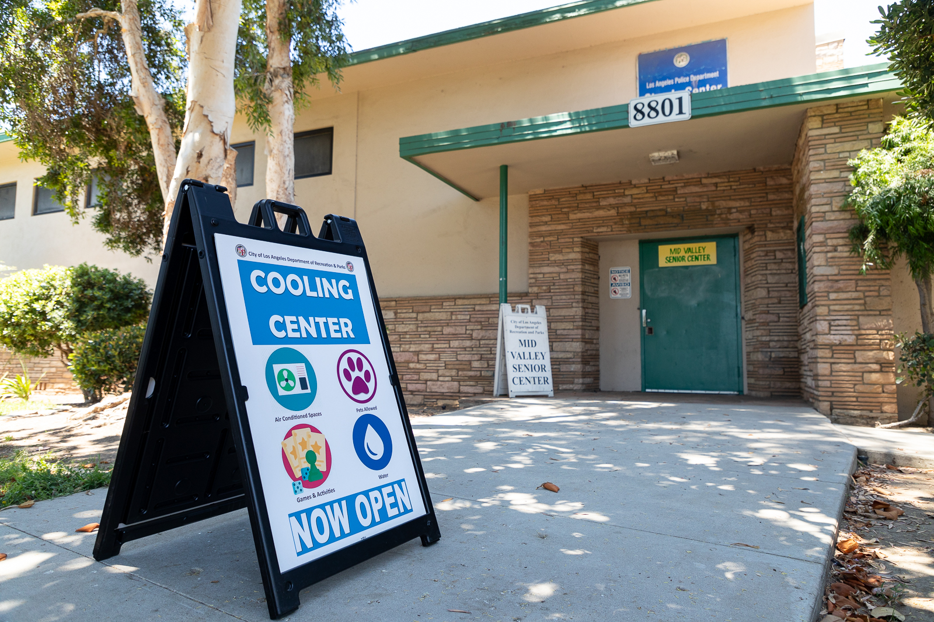
When Smoke and Excessive Heat are Present
Your Tribe may decide to open a Cooling Center or Shelter.
  Cooling Centers offer:
    Air Conditioning,
    Water,
    Food,
    Support Services such as:
      Transportation,
      Medical/first aid,
      Electronics charging.
  Shelters offer the same except are open 24 hours and will have onsite sleeping arrangements.

Slide 23
How to prepare for wildfire smoke

Slide 24
Preparing for Wildfire Smoke
Have a Plan
  Sensitive Groups:
    Plan to leave the area or stay with a friend/relative during Hazardous AQI levels.
    Know ahead of wildfire season where cleaner air facilities will be located in your community. Your Tribal Health Program or Tribal Office of Emergency Services will be able to tell you the usual locations.
    Keep a supply of your medications that will last at least 7 days in case you need to evacuate or stay at a shelter.

Slide 25
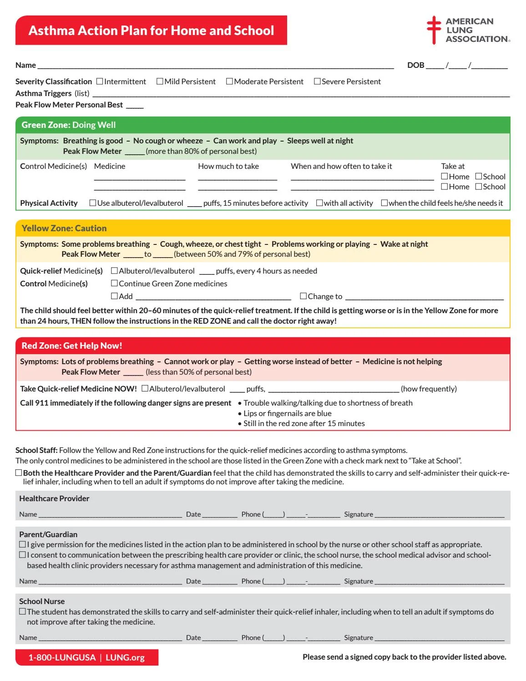
If You Have Asthma
Speak with your healthcare provider and prepare an Asthma Action Plan.
Keep a 7-10 day supply of medication in a waterproof container.
Notes:
https://issuu.com/atlspeechschool/docs/asthma-action-plan_44681_
https://www.cdc.gov/air/wildfire-smoke/asthma.htm

Slide 26
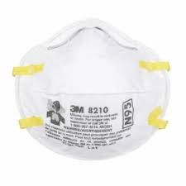
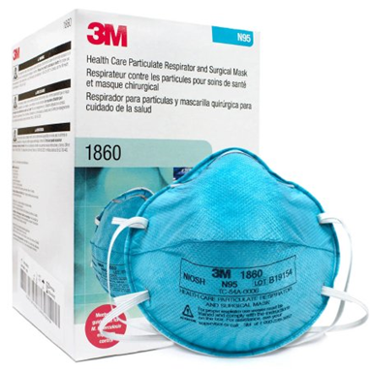
Preparing for Wildfire Smoke
Keep a supply of N-95 Respirators.
  Ensure they are NIOSH approved.
  Keep at least one box of 20 respirators/person for fire season.
    N95s should not be placed on children as they will not produce a proper fit.
  If you have lung or heart disease it is recommended to talk to your doctor before wearing an N-95 respirator.
    N-95s make breathing more difficult due to the air having to pass through a filter.
  N95 respirators can be reused during a smoke event.
    Discard when soiled or damaged.
*The Indian Health Service does not endorse these brands or their products, these are just examples*

Slide 27


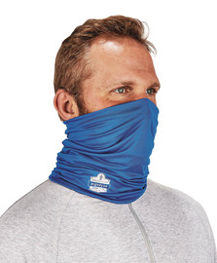
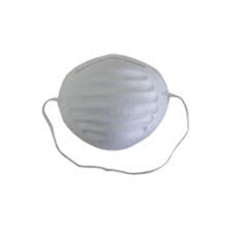
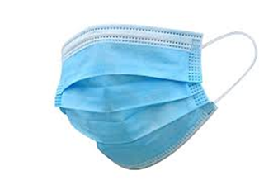
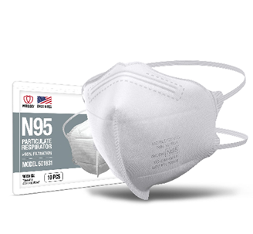
N-95 Respirators
Should have two straps that go around the head and be a snug fit.
Dust masks (paper masks) or masks with one strap or two straps that loop around the ear will not protect you from PM2.5.
  Will not produce a snug fit or do not have needed filtering capabilities.
Notes:
https://www.airnow.gov/sites/default/files/2021-07/respiratory-protection-factsheet-072021.pdf

Slide 28
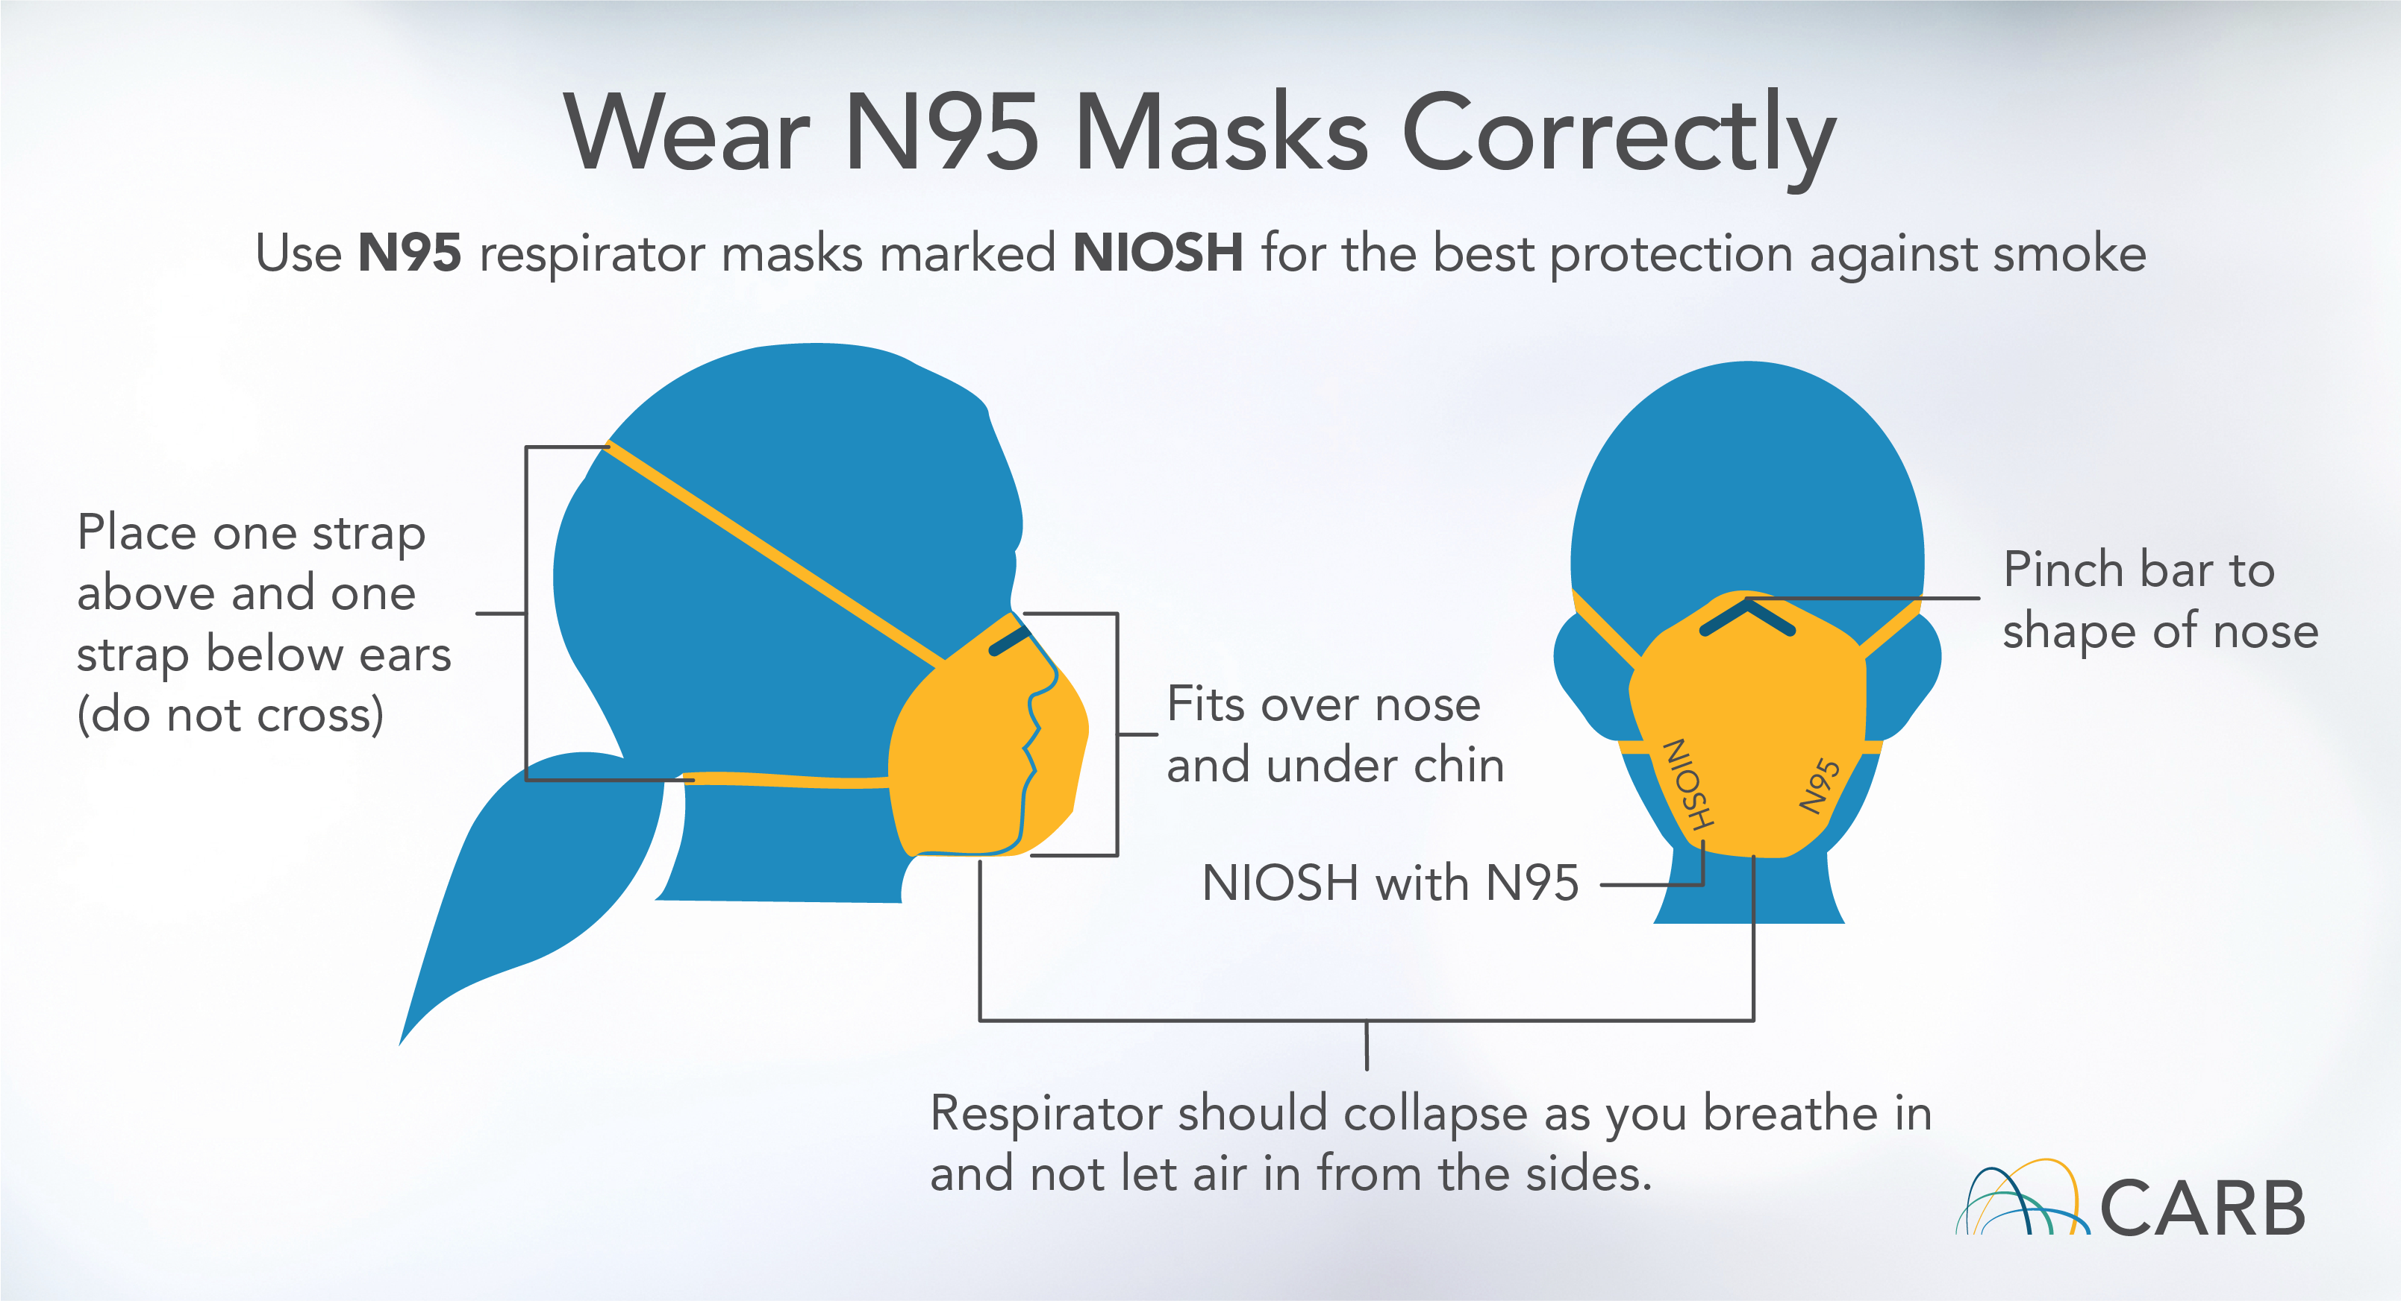
N-95 Respirators
Notes:
https://www.airnow.gov/sites/default/files/2021-07/respiratory-protection-factsheet-072021.pdf

Slide 29
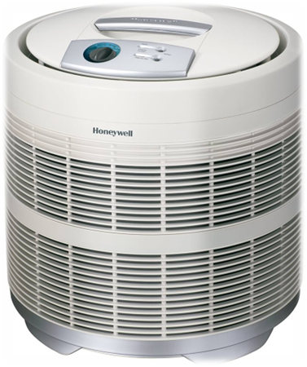
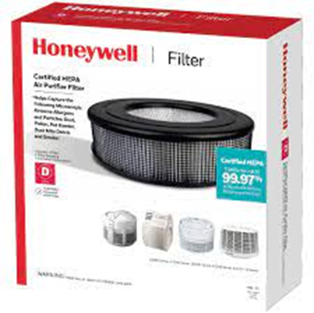
Preparing for Wildfire Smoke
Acquire a portable HEPA Air Purifier.
  Should be CARB certified.
    CARB Certified Air Cleaning Devices List
    CARB certification shows that the air purifier meets electrical safety and ozone emission standards9.
    Size the Air Purifier needed by this equation
      X CFM =(5 * (Room Length * Width* Height))/ 60
    Can also use Clean Air Delivery Rate (CADR) rating for tobacco smoke to size for intended room. CADR rating for tobacco smoke should be at least 65% of the room size in square feet (not volume! CADR assumes a room height of 8 feet).
  The advertised square footage should meet or exceed the size of the intended room.
  Should maintain a supply of filters and change them according to manufacturer’s instructions.

Slide 30
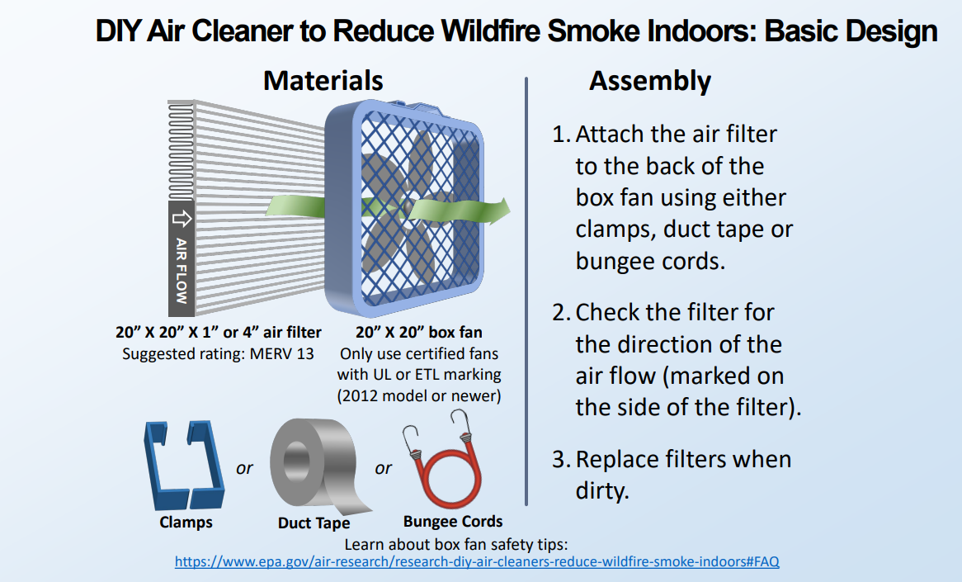
DIY Air Cleaner
If you do not have access to a commercial portable HEPA Air Purifier, you can DIY one.

Slide 31
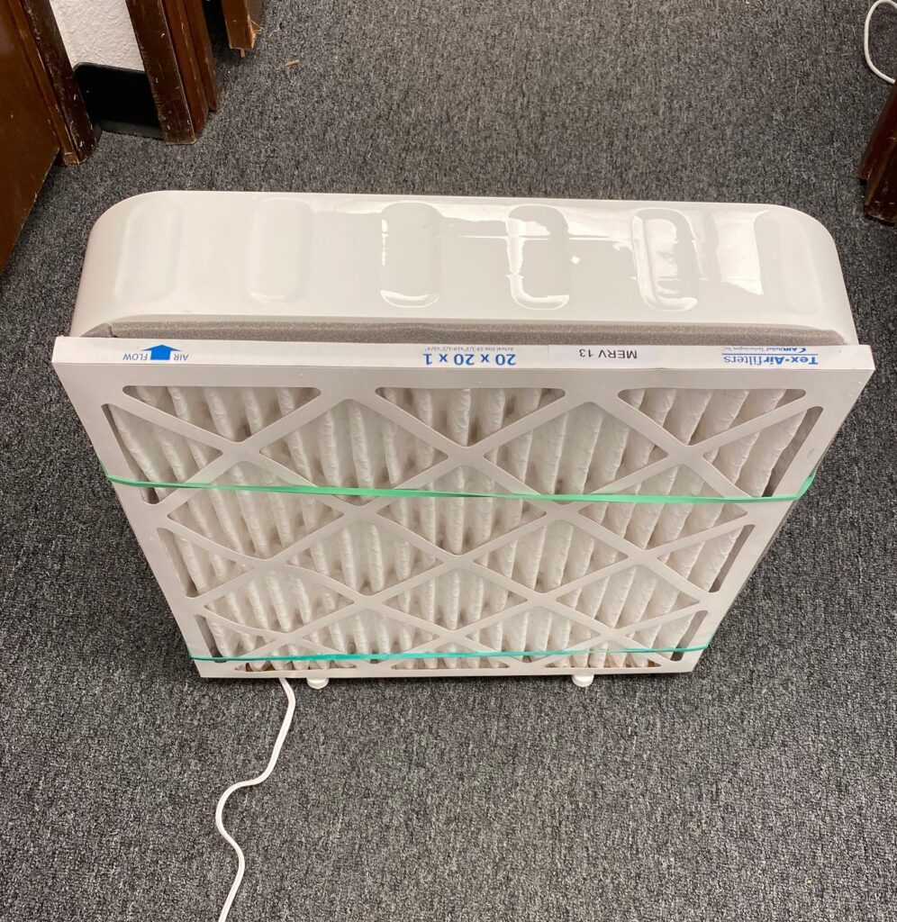
DIY Air Cleaner
Tips:
  Use a UL or ETL approved box fan that is a 2012 or newer model.
    Fans modeled prior to 2012 don’t have new safety features that prevent the motor from overheating and may pose fire risk.
  Have extra MERV 13 filters on hand.
    During heavy smoke, they may need to be changed every few days.
  Useful for small rooms, such as bedrooms.

Slide 32
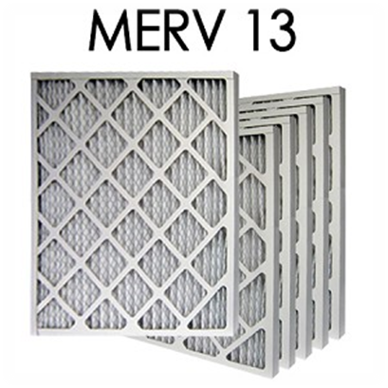
Preparing for Wildfire Smoke
If you have Central Air Conditioning, install a MERV 13 filter if your system can handle it.
  Higher rating filters may overload system, so check manufacturer’s recommendations before using a MERV 13 filter in your home’s air conditioning system.
5. Assess home and ensure it is weatherized.
  Seal any intrusion points around doors and windows.
  Close your fireplace damper to prevent smoke from coming in through the chimney.

Slide 33
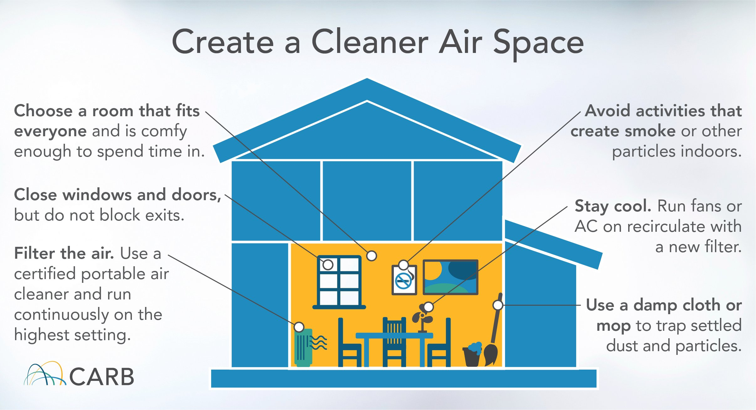
Preparing for Wildfire Smoke
Plan to Have a Clean Air Room in your home:
  Especially if you cannot keep smoke out of the home;
  Choose a room with sealed doors and windows and preferably with attached bathroom;
  Outfit room with a portable HEPA air purifier that is sized for the square footage of the room;
  Use fans to cool the air, do not use evaporative coolers (a.k.a. “swamp coolers”) as they pull unfiltered outside air into the home.
Source: https://www.epa.gov/indoor-air-quality-iaq/create-clean-room-protect-indoor-air-quality-during-wildfire
Notes:
https://www.epa.gov/indoor-air-quality-iaq/create-clean-room-protect-indoor-air-quality-during-wildfire
https://ww2.valleyair.org/grants/clean-air-rooms-program/

Slide 34
References
Minnesota Department of Health: Wildfire Smoke and Health
UC Davis Environmental Health Sciences Center: Environmental Health Impacts of Wildfire
Journal of Thoracic Disease: The impact of PM2.5 on the human respiratory system
US EPA Brochure: Particle Pollution and Your Health
US EPA: How does PM affect human health?
US Forest Service Flyer: Wildfire Smoke and Your Health

Slide 35
References
CDC: Private Wells after a Wildfire
USGS California Water Science Center: Water Quality after a Wildfire
Journal of Environmental Health: Synergistic Health Effects of Air Pollution, Temperature and Pollen Exposure
The Lancet Planetary Health: Heatwaves and wildfires suffocate our health start to life
American Journal Respiratory Critical Care Medicine: Heatwaves and Air Pollution—a Deadly Combination
UCLA Newsroom: Dangerous combination of extreme heat and smoke affected 16.5 million Californians

Slide 36
References
US EPA Flyer: Wildfire Smoke Factsheet
CDC: Wildfire Smoke and People with Chronic Conditions
US EPA: Which Populations Experience Greater Risks of Adverse Health Effects Resulting from Wildfire Smoke Exposure?
New York State Department of Health: Exposure to Smoke from Fires
Clark County Washington Public Health: Smoke from Wildfires
International Journal of Environmental Research and Public Health: Wildfire Smoke Exposure During Pregnancy

